Slide 1

J.R. AVIATION SERVICES
“GOVT. APPROVED RECRUITING LICENCE NO. RL-293”
J.R. AVIATIONSERVICES
COMPANY PROFILE

Slide 2

WHO WE ARE
Corporate Profile
J.R. Aviation Services is a government-approved recruiting agency of Bangladesh, established in 1991 and holding Recruiting Licence No. RL-293. For more than three decades we have recruited, processed and deployed Bangladeshi manpower across Malaysia, Saudi Arabia, Brunei and the U.A.E.
Every candidate is selected with care, medically screened at embassy-authorised centres, and briefed on the duties and labour laws of the host country before departure.
Our record in Malaysia is our pride: 103 Malaysian employers have recruited through us, in mobilisations of up to 624 workers for a single principal.
1991
ESTABLISHED
IN DHAKA
RL-293

Slide 3
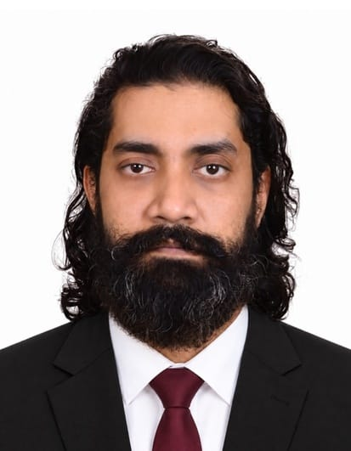
A WORD OF WELCOME
Message from the Proprietor
“
Rajib Ahmed Bhuiyan
PROPRIETOR

Slide 4
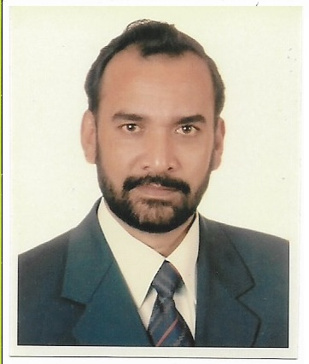
SINCE 1991
Where It Began
J.R. Aviation Services was founded in Dhaka in 1991 and has carried the government recruiting licence RL-293 — issued under Section 10 of the Emigration Ordinance, 1982 — ever since.
Three decades on, the same single office on Motijheel C/A has placed workers with 103 Malaysian employers, mobilised as many as 624 workers for one principal, and extended into Saudi Arabia, Brunei and the U.A.E.
“We always stand not for good, but for the better.”

Slide 5
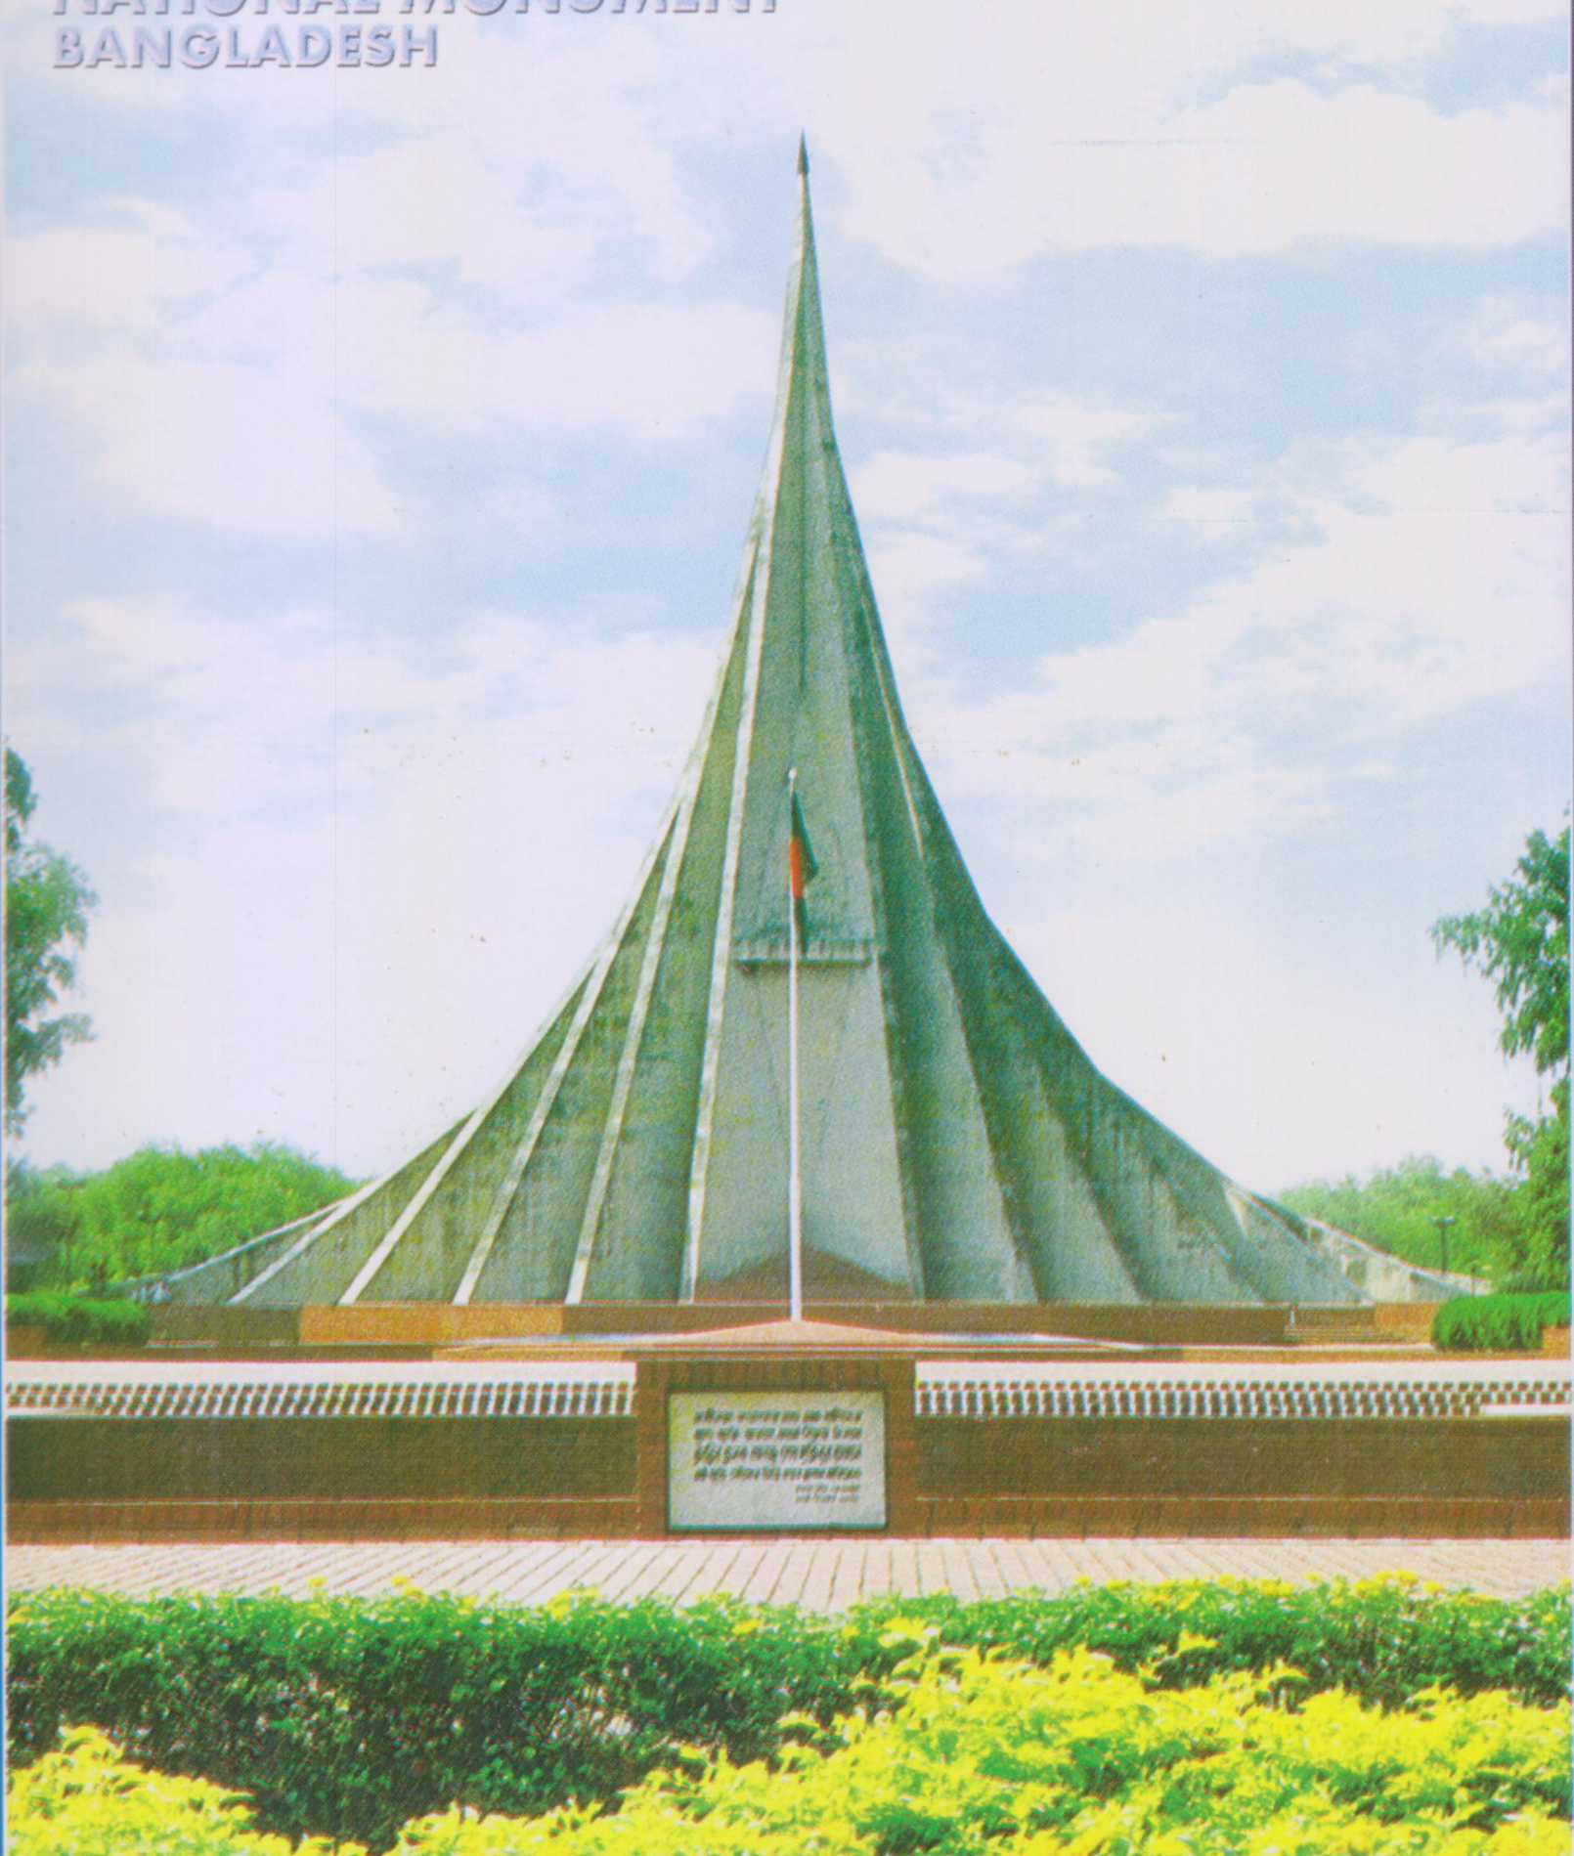
THE WORKFORCE
Why Bangladesh
Jatiya Sriti Soudho, Savar —
the nation our people carry with them.
01
Cost-Competitive
A workforce that keeps your projects competitive without compromising output or quality.

Slide 6
HOW WE WORK
Recruitment Procedure
The Employer's Part
1
Demand Letter

Slide 7
WHAT WE SUPPLY
Categories of Manpower
Office Management
Engineering

Slide 8

OUR STRONGEST MARKET
The Malaysian Track Record
103

Slide 9
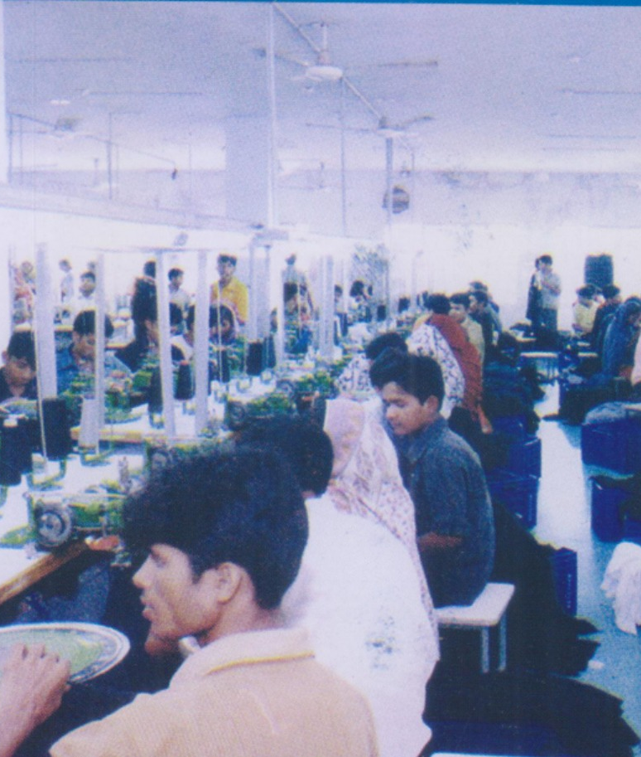
BEYOND MALAYSIA
A Gulf-Wide Reputation
Saudi Arabia
13
EMPLOYERS SERVED

Slide 10
THE TEAM
Organisation Set-Up
PROPRIETOR
GENERAL MANAGER
ADVISOR
MANAGER ADMINISTRATION

Slide 11
J.R. AVIATION SERVICES
GOVT. APPROVED RECRUITING LICENCE NO. RL-293
Shahnewaz Bhaban, Room #6-8 (3rd Floor)
9/C Motijheel C/A, Dhaka-1000, Bangladesh
Rajib Ahmed Bhuiyan, Proprietor — +88 01805-465090
Office — 01805-465099 · 01805-465091

